Slide 1
VIKING COMMUNITY FUND
YEAR 1 REPORT
2024/25

Slide 2
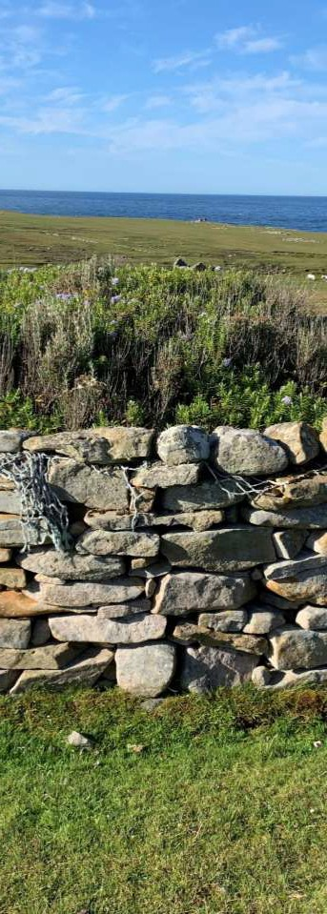
TABLE OF CONTENTS
Note from the SCBF Chair
Viking Community Fund
Overview of Funding Allocation
Strategic Fund
The VCF Bursary Fund
Energy Efficiency Grants
4
5
6
8
9
6 Strategic Project in Focus - FIRMO
10
7 Full list of Strategic Projects
11
8 Community Grant Scheme (CGS)
12
9 CGS – Projects in Focus
15
10 Full list of CGS Projects
17
11 Funding Map
19
ii

Slide 3


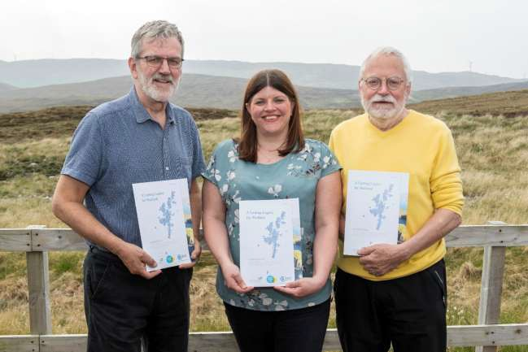
NOTE FROM THE SCBF CHAIR
While the first year of managing the Viking Community Fund has not been without its challenges it has also been very rewarding having reached the milestone of approving grants worth over £1.4 million towards 69 projects. A tremendous amount of work by our volunteer directors and staff has gone into ensuring the smooth launch of the fund. We have learnt the lessons of planning, good governance and a straightforward application process and look forward to supporting many more initiatives that will help strengthen our local communities.
Chris Bunyan, SCBF Chair
Colin Clark, SCBF Director, Lindsay Dougan, SSE Renewables Senior Community Investment Manager and Chris Bunyan, SCBF Chair.

Slide 4
1. VIKING COMMUNITY FUND
The £2.2million Viking Community Fund launched on the 1st of September 2024. This followed an extensive Shetland-wide community consultation and publication of the first 5- year business plan for use of the fund.
The VCF has two strands – a ‘Strategic Fund’ and a ‘Community Grant Scheme’ which both
aim to sustain and develop local communities throughout Shetland.
Strategic Fund
Applications to the Strategic Fund must also meet one or more of the Strategic priorities,
More Younger People Wanting to Stay and/or Come Back to Shetland
Better Transport Links within and Between Communities
Reduced Cost of Living in Shetland
Better Broadband and/or Mobile Phone Connections
Improved Housing Supply and Affordability
Preservation and Enhancement of Shetland’s Natural Environment
Community Grant Scheme (CGS)
The CGS carries on the good work of the Advanced Grant Scheme (AGS) which operated during the construction phase of the Viking Energy Windfarm. Funding is allocated to all 18 community councils on the same share basis as was used for the AGS.
1 share areas = £6,515 5 share areas = £32,575
Tier 1 Grants of £50 to £1,000
Tier 2 Grants £1,001 and above
Tier 3 Grants of £200 to £15,000
Tier 1 and Tier 2 decision making lies with the relevant community council. For Tier 3 a funding panel, made up of SCBF directors, allocate funding. Tier 3 is new for the CGS and was created in recognition of the volume of applications to the AGS from Shetland-wide groups and organisations who deliver projects with a wider reach than individual community council areas. SCBF fully administrate the CGS and carry out due diligence, payments and evaluation.

Slide 5





2. OVERVIEW OF FUNDING ALLOCATIONS
Viking Community Fund
The annual fund amount from the Viking Community Fund is £2,215,000 (index-linked).
Strategic priorities annual allocation - £1,637,000*
* This figure was reduced by £200,000 in Year 1 to £1,497,000 to reflect an existing commitment of £200,000 to the MRI Scanner Appeal.
Community Grant Scheme annual allocation - £356,500
£221,500 is distributed between Shetlands 18 community councils and Tier 3 for Shetland- wide projects has an annual funding allocation of £135,000.
Fund Administration – maximum of £221,500 available
10% of the main fund is available for administration costs to deliver the fund. Such costs include, staffing, legal and accountancy services and website fees. SCBF spent £112,166 on administration costs in 2024/25.
VCF Allocations
10%
16%
74%
Strategic
CGS
Administration
The largest amount of funding, almost three quarters, is focused on the Strategic fund to support the Strategic priorities delivered by the community consultation and adopted by the SCBF Board of Directors.

Slide 6




3. STRATEGIC FUND
VCF Strategic Fund
£1,637,000 was available to projects and intiatives which supported the VCF Strategic priorities for funding. £1,084,460 has been awarded up to the 31st of August 2025 when the first year of funding ended. This figure includes an earlier drawdown of £200,000 in October 2020 to support the local MRI Scanner Appeal and also £32,710 to support a volunteer development worker post which crosses between the Strategic Priorities and the CGS.
The unspent £552,540 has been carried over and added to the funding available for 2025/26.
Strategic Spend
17%
50%
33%
Available
Awarded Remaining
Actual spend across each priority area
Reduced Cost of Living in Shetland | £484,516
More Younger People Wanting to Stay and/or Come Back to Shetland | £222,891
Preservation and Enhancement of Shetland’s Natural Environment | £97,073
Improved Housing Supply and Affordability | £14,500
Better Transport Links within and Between Communities | £32,770
Better Broadband and/or Mobile Phone Connections | £0.00

Slide 7










SPEND PER PRIORITY
484,516.00
225,891.00
97,073.00
0.00
14,500.00
32,770.00
Broadband/IT Cost of living Environment
Housing
Transport
Younger People
Percentage spend by priority
0%
26%
Broadband/IT
Cost of living Environment
Housing Transport
Younger People
4%
2%
11%
57%
Strategic funding supported 12 projects/initiatives, 64 individuals with bursaries and training grants and 11 businesses through the apprenticeship support fund for small businesses. A full list of strategic projects supported by the fund can be found on page 11.

Slide 8





4. THE VCF BURSARY FUND
SCBF implemented three funding schemes centred around studying, apprenticeships and training to target the priority of ‘More Younger People Wanting to Stay and/or Come Back to Shetland’.
Bursary Fund
The bursary fund opened for the first time in October 2024 for young people up to 25 studying full-time at UHI Shetland or undertaking a local apprenticeship. 71 awards were made in 2024/25 totalling £61,763. Feedback on the scheme was very postive.
“The SCBF bursary fund really helped me get started with my modern apprenticeship in carpentry & joinery. It enabled me to purchase some of the basic tools I need to learn and develop my skills required for my apprenticeship.
I would highly recommend the bursary fund to any apprentices or students working/studying in Shetland”
Michael, Joinery Apprentice
“The process was simple and easy to follow. The people involved were easy to contact and explained everything to me well. I would recommend it to other apprentices”
“It's been a very positive and beneficial experience, thank you for this opportunity”
Magnus, Electrical Apprentice
Ewan, Plumbing Apprentice
"It was a great help to get a bursary and the process was kept straightforward.
Thank you”
Kieran, NC Engineering Student
“Made my experience of my studies easier and more relaxed”
Reece, Civil Engineering Apprentice

Slide 9
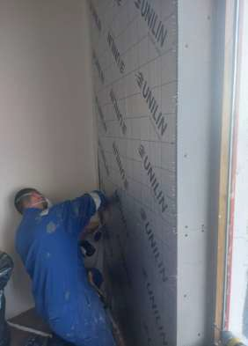
5. ENERGY EFFICIENCY GRANTS
Scottish Government Area Based Scheme - £200,000 grant top-up/windows and doors funding - delivered by Shetland Islands Council
Shetland Islands Council are administering
£200,000 in grant top-up funding from the VCF alongside the Scottish Government’s Area Based Scheme (ABS). The ABS is awarded to local
authorities to develop and deliver energy efficiency programmes in areas with high levels of fuel poverty. It is a blended model of grant funding and owner contribution for energy efficiency measures. The Viking Community Fund is being used to top-up the ABS grant where the homeowner is unable to contribute to the costs themselves. Funding is also available for windows and doors, which are not currently covered as a primary measure, under the ABS. New windows and doors reduce make a great difference to heat loss particularly in exposed areas. 9 properties have benefitted so far with a further 13 approved for funding and awaiting installation.
Training Grants - £23,680 - Hjaltland Housing Association and Shetland Renovations Ltd
An award of £10,000 to Hjaltland Housing Association finalised the funding required to deliver Air Tester, Retrofit Co-ordinator, Retrofit Assessor and Retrofit Advisor training to up-skill staff in energy efficiency measures. Having this skill within the in-house staff team will assist in planning retrofit measures on existing stock, support future funding bids and ensure the letting of new builds is not delayed through the requirement for air testing.
Shetland Renovations Ltd were awarded £13,680 to train 3 members of staff to NVQ level
in ‘Room in Roof (RIR) and ‘In Wall Insulation (IWI)’ retrofit energy efficiency measures. This project aims to improve the supply chain of installers qualified to PAS2030 and tackle the backlog of insulation measures requiring completion in Shetland.

Slide 10
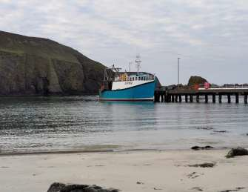
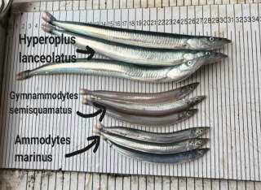
6. STRATEGIC PROJECT IN FOCUS – FIRMO
Fair Isle Research Marine Organisation - £17,273
Supporting the Strategic Priority of the ‘Preservation and Enhancement of Shetland’s Natural Environment’ the Fair Isle Research Marine Organisation was awarded £17,273 in February 2025 towards the costs of carrying out a sand eel survey in the waters around Fair Isle. The fine weather in May allowed for long survey days and the marine scientists from UHI Shetland achieved good survey coverage with 18 valid tows on sandbanks between the east and west of the island.
So far, preliminary results demonstrate clear spatial differences in the catch rates and species compositions that relate to both depth and east vs west, with overall catch rates generally highest on the shallowest areas of each of the banks. Results show three species of sandeel including smooth sandeel Gymnammodytes semisquamatus, greater sandeel Hyperoplus lanceolatus and Raitt's sandeel Ammodytes marinus with the bulk of catches being smooth.
More detailed findings from the survey will be coming soon following formal analysis. This important research will help to gain a better understanding of Fair Isle sandeel populations, how they compare to populations across the rest of Shetland and other areas, and what this might mean for Fair Isle’s seabirds.
*Photos credit Shaun Fraser

Slide 11
7. FULL LIST OF STRATEGIC PROJECTS
Applicant/Overview
Amount
Shetland Health Board Endowment Fund
MRI Scanner Appeal
£200,000
Shetland Islands Council – Energy Efficiency
ABS grant top-up and Windows/doors funding for fuel poor and extreme fuel poor households
£200,000
VCF Apprenticeship Support Fund
To support 11 businesses who are employing an apprentice under the age of 25 across years 1-3 of their apprenticeship
£139,999
Brae Rural Energy Hub
Towards staff costs of 1.6 FTE for 4 years Nov 25 to Oct 29
£114,349
Fair Isle Electricity Company
Towards critical technical upgrade of micro grid
£86,487
South Nesting Boating Club
Environmental Impact Assessment for marina project
£79,800
VCF Bursary Fund
71 students and apprentices awarded up to £1,000
£61,763
Scalloway Community Development Company
Towards district heating feasibility study
£60,000
Royal Voluntary Service (RVS)
Part-time driver for accessible vehicle over 3 years
£32,770
Voluntary Action Shetland
VAS Volunteering Development Worker
£32,710
Shetland Youth Voice
To deliver 6 Shetland Youth Voice summits on varied themes
£23,850
Fair Isle Marine Research Organisation
Sand eel Survey
£17,273
RCS Ltd and L&L Fraser Ltd
25 days of housing consultancy support to community groups
£14,500
Shetland Renovations Ltd
Energy efficiency training (IWI and RIR NVQ for 3 Learners)
£13,680
Hjatland Housing Association
Training to up-skill staff in retrofit energy efficiency works
£10,000
VCF Training Fund
Accredited training funding for young people
£2,279

Slide 12
8. COMMUNITY GRANT SCHEME
Community Councils Spend overview
Community councils began the 2024/25 funding year with varying opening balances due to funding of £316,015 carried forward from the Advanced Grant Scheme (AGS) which ended on the 31st of August 2024. Community councils with unspent AGS funds had these added to their CGS allocations for 2024/25. £221,500 was then divided between them on a 1 or 5 share basis.
Community Funding Council carried | 2024/25 allocation | Funding available | Total spend | Balance Remaining
forward |  | 2024/25 | 2024/25
from AGS
_{Bressay} £22,398 | £6,515 | £28,913 | £2,476 | £26,437
Burra & Trondra ^{£15,471} | £6,515 | £21,986 | £2,000 | £19,986
_{Delting} £37,512 | £32,575 | £70,087 | £42,284 | £27,803
Dunrossness ^{£160} | £6,515 | £6,675 | £5,606 | £1,069
Fetlar ^{£630} | £6,515 | £7,145 | £0 | £7,415
Gulberwick, Quarff £13,055 & Cunningsburgh | £6,515 | £19,750 | £1,400 | £18,170
Lerwick ^{£779} | £6,515 | £7,294 | £1,500 | £5,794
Nesting & £5,062 Lunnasting | £32,575 | £37,637 | £20,146 | £17,491
Northmaven ^{£9,336} | £6,515 | £15,851 | £9,674 | £6,177
Sandness & Walls ^{£10,392} | £6,515 | £16,907 | £13,944 | £2,963
Sandsting & £302 Aithsting | £32,575 | £32,877 | £13,643 | £19,234
Sandwick ^{£7,467} | £6,515 | £13,982 | £400 | £13,582
Scalloway* ^{£2,307} | £6,515 | £8,822 | £15,302 | -£6,480
Skerries ^{£37,250} | £6,515 | £43,765 | £43,500 | £265
Tingwall, £147,882 Whiteness & Weisdale** | £32,575 | £180,457 | £22,116 | £158,341
_{Unst} £1,448 | £6,515 | £7,963 | £1,833 | £6,130
Whalsay ^{£0} | £6,515 | £6,515 | £5,000 | £1,515
_{Yell} £4,564 | £6,515 | £11,079 | £8,756 | £2,323
*Scalloway CC opted to drawdown funding from 2025/26 and will begin 2025/26 with £35 (£6,515 - £6,480 drawndown).
**TWW CC plan to utilise their funding for a large upcoming project.

Slide 13








1- SHARE CC' S - £6, 515 ANNUALLY
Available Awarded Balance Remaining
£50,000
£45,000
£40,000
£35,000
£30,000
£25,000
£20,000
£15,000
£10,000
£5,000
£0
5 Share CCs - £32,515 Allocated Annually
£200,000
£180,000
£160,000
£140,000
£120,000
£100,000
£80,000
£60,000
£40,000
£20,000
£0
Delting
Nesting & Lunnasting Sandsting & Aithsting
T, W & W
Available Awarded Balance Remaining
Community councils are permitted to drawdown funding from future years (up to 5) if they want to support projects but have insufficient funds to do so. Any drawdown is reflected in the following years availability of funds. Some communities will also be aware of larger projects due in future and may opt to retain funds for these.

Slide 14
Tier 1 and Tier 2 Applications
Community councils supported 21 Tier 1 and 21 Tier 2 applications throughout the 2024/25 funding year.
Tier 1 applications between £50 and £1,000 accounted for £17,057 in grant awards with Tier 2 applications over £1,001 being awarded £192,523 between them.
Tier 3 Community Grant Scheme (CGS)
SCBF introduced Tier 3 to the CGS for organisations delivering projects with a wider reach than individual community council areas. An annual funding pot of £135,000 was made available with 3 application rounds opening throughout the year.
£119,624 was shared between 12 projects. The underspend of £15,376 will be carried into the CGS Tier 3 in 2025/26.
CGS Tier 3
£140,000
£120,000
£100,000
£80,000
£60,000
£40,000
£20,000
£0
Available
Awarded
Grants supported 2 multi-year projects, one for an educational drugs delivery programme and the other for a Netball Training co-ordinator. The other 10 projects were one-off events, renovations or 1-year staffing costs. A full list of projects supported by the CGS can be found on pages 18 and 19.

Slide 15
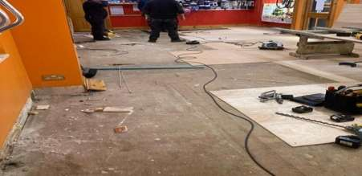
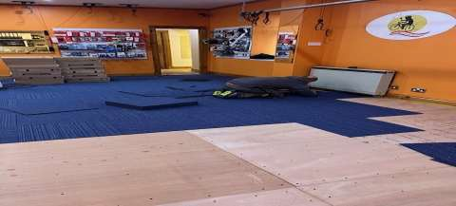
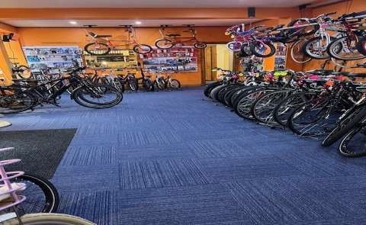

9. CGS – PROJECTS IN FOCUS
Shetland Community Bike Project – New shop flooring - £8,059
A fresh new look for the Shetland Community Bike Project following an award of £8,059 from the Viking Community Fund CGS Tier 3 in November 2024. The existing flooring was 20 years old and in need of a revamp.
The shop serves the whole Shetland community and the new flooring enhances the inside of the shop making it a more pleasant experience for customers, staff and volunteers.
Feedback from applicant
“The fund application and award process was very straightforward. The board of directors, staff and clients are extremely grateful to SCBF for the grant award. Thank you!”
Shetland Community Bike Project Manager,
Caroline Adamson

Slide 16
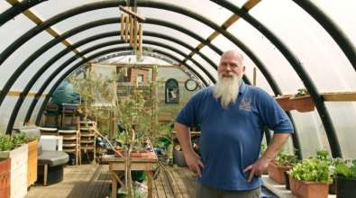
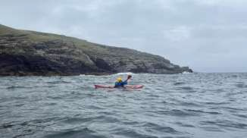

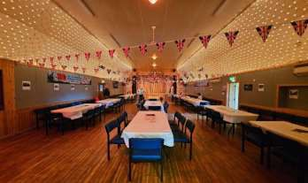
The Outpost – Generator - £1,000
The Outpost received funding in October 2024 towards the purchase of a back-up generator to use during power cuts. Service users and their support workers could often have sessions disrupted due to power outages and the new generator ensures peace of mind and safety for all visitors.
Shetland Canoe Club - bringing a trainer to Shetland to deliver Trip Leader/Coach training - £2,000
Travelling to the mainland to access training can be cost prohibitive for many local organisations who rely upon volunteers for delivery of their clubs/services. Shetland Canoe Club were able to bring a Trip Leader/Coach trainer to Shetland at the end of April 2025.
Alongside other funding a grant of £2,000 from the VCF supported the total cost of £3,370. Being able to deliver the training for free to volunteers removed the financial barrier to access the training. 27 people directly benefited from the training sessions with the club now expecting to offer coaching to ~100 different people over a year, with sessions offered multiple times per week.
VJ Day Volunteer Group (Unst) – 80th Anniversary of VJ Day Social Event - £833
A group of volunteers were able to deliver a free social event in the North Unst community hall to celebrate the 80th anniversary of VJ Day.

Slide 17
10.FULL LIST OF CGS PROJECTS
A total of £329,204 has been allocated to CGS Projects
Applicant Overview Applicant Overview
Amount
Skerries Community Hall
To purchase a scaffolding tower, windows and fire escape doors
Amount
Walls & District Agricultural Society
Funding towards constructing a steel framed shed
£43,500
£10,000
Brae Community Hall
Upgrades to hall car park
£34,200
Shetland Community Bike Project
New shop flooring
Dogs Against Drugs
Funding towards delivering a drugs educational program across 3 years
£8,059
£30,000
Tingwall Community Hall
Hall upgrade costs
Community Development Company of Nesting (CDCN) Installation of Solar PV panels and battery storage at the Aald Skul Community hub
£7,500
£15,492
Voe & District Agricultural Society Ltd
New cattle gates
£7,092
Shetland Netball Association Funding towards employing a Netball Development Co-ordinator across 3 years
Yell Show Committee
Re-cladding of wall and replacing roof sheets of shed
£7,000
£15,000
Delting Dolphins ASC
Purchase of swimming equipment & rebranding costs
Ability Shetland
Funding to employ an activities co- ordinator for 1 year
£6,448
£15,000
Shetland Youth Orchestra Summer school and equipment purchases
Win Furt
Funding towards Phase 1 of Paths for All
£6,270
£12,850
Walls Regatta Club Purchase of new rescue boat & engine
Edinburgh Science
£6,143
To deliver ‘Our Changing Climate’ workshops in Shetland primary schools | £12,757
ALICE Theatre Project Theatre Course in Liverpool and | £10,244
production in Shetland
Fraser Park Trust To purchase a ride on mower and | £10,302
pedestrian mower
Mind Your Head Wellbeing 1000 groups practitioner | £10,000
for 1 year
The Shetland Clarsach Society
Purchase of harps
£5,000
Whalsay Sports Development Trust
Upgrade the perimeter fencing at Harbison Park football pitch
£5,000
Scalloway Community Development Company Consultancy Support for Scalloway Waterfront Redevelopment Project
£5,000
Shetland Film Archive
Towards cost of a Project Manager to
lead ‘Connecting Communities
£4,624

Slide 18
Applicant Overview
Amount
Applicant Overview
Amount
The Gruting & District Community Association External maintenance to the building
1st Aith Brownies
To introduce a film-making focus
£1,000
£4,370
Bressay Up Helly Aa Committee Purchase of pallet truck, electric pump and COSHH cabinet
Bigton Community Shop
Car park improvements
£3,850
£976
Westside Sharks Swimming Club Towards competition fees, summer and winter ball
Bigton Collective
Hosting straw workshop
£956
£3,420
Lunnasting Young Ones Club Purchase of new equipment and roller skates
Hillswick Shop Ltd
Towards purchase of new chill unit
£3,000
£920
Hillswick Public Hall SCIO
Towards upgrade of extraction system
£2,255
Voe Children's Party
Towards Christmas party/presents & equipment
Shetland Canoe Club
To deliver trip leader/coach training
£850
£2,000
VJ Day Volunteers
To host a social evening for VJ Day
£833
Baltasound JHS Parent Council Funding towards North Isles P6&7 trip to Loch Insh
Tingwall Youth Club
Purchase of sports equipment and craft kits
£2,000
£766
South Mainland Amateur Swimming Club
Towards reducing the cost of race entry fees
Yell Community Council Funding for 2025 ‘Keep Scotland's Beautiful’ Scottish Beach Awards
£1,600
£756
Ella's Park
Funding for fencing and picnic table at Ella's Park
Shetland Golf Club
Towards hosting a golf competition for blind or partially sighted competitors
£1,500
£670
The Outpost
Purchase of a fuel powered generator
£1,000
Cunningsburgh Under Fives Purchase of STEM toys and equipment
Sandness Parent Council
Purchase of nest swing
£500
£1,000
Gulberwick Toddlers
Purchase of new toys
£500
Brae Christmas Party
Towards Christmas party/presents
£1,000
Bixter & Aith Parent Group Funding towards outings and Christmas party/presents
Lerwick Community Council
To run a dog fouling campaign
£1,000
£500
Langsound Community Development Group Repainting of the toilet facility
1st Aith Guides
Towards cost of summer camp trip to Aberdeenshire
£1,000
£500
Whiteness & Weisdale Good Companions
Towards outings and events / activities for the local community
St Magnus’ Episcopal Church
Upgrade to tourist information boards
£500
£1,000
Delting Dolphins ASC Towards costs of attending 2025 Aquatics GB next Gen Championships
1st Aith Rainbows
Towards trip to Lerwick museum
£500
£1,000

Slide 19
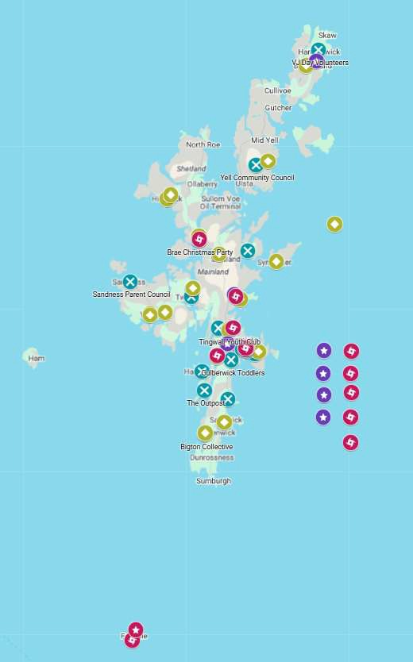
11. FUNDING MAPS
Funding has been awarded throughout Shetland from Unst to Fair Isle supporting a wide variety of projects. To access the interactive funding map please visit – SCBF - Funding Map
21 Tier 1 Projects
21 Tier 2 Projects
12 Tier 3 projects
15 Strategic Projects
Shetland- Wide Applications

Slide 20
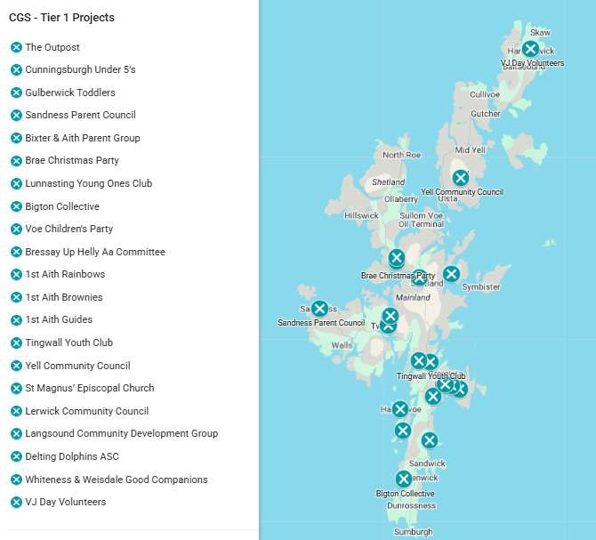
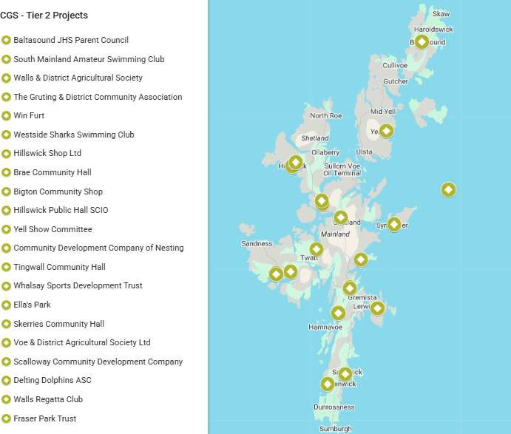

Slide 21
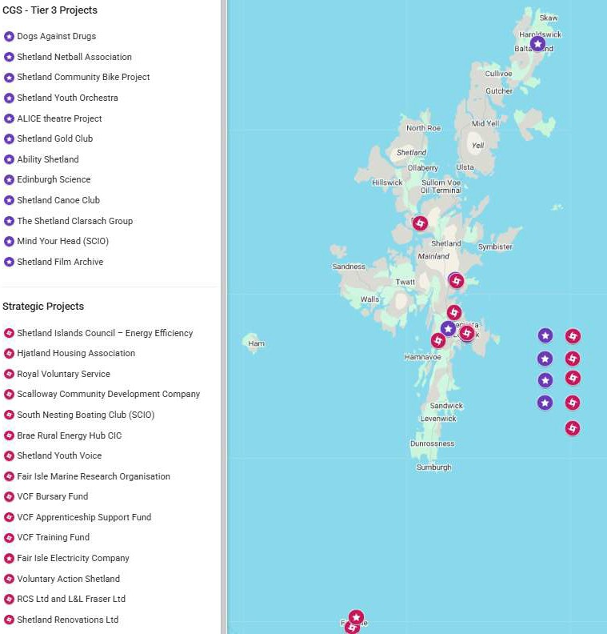
Shetland- Wide Applications

